Slide 1

Capstone Presentation
Faith Based Services
Michael Siebert
INFM 480
Dr. Feng Liu

Slide 2
Purpose of Study/Background
To support a locally-owned business be more efficient with technology.
For a close friend that I helped start the business.
To help others embrace technology.
Making a simple, easy to use platform to book handyman services and possibly more.
Provide a foundation for other companies to use.
Get out of the complex, hard to use platforms.

Slide 3
Project Deliverable
Will be a working prototype of the potential application.
The prototype will be tested by an ideal or prospective user that is familiar with the company.
A task list will be given for the user.
The user will complete a survey at the end.

Slide 4
Measurements for Success
To create a useful, easy to use mobile application prototype.
To create a positive experience when prototyping the model.
Have constructive feedback on the results of the case study.
Complete the basic tasks on the user task list.

Slide 5
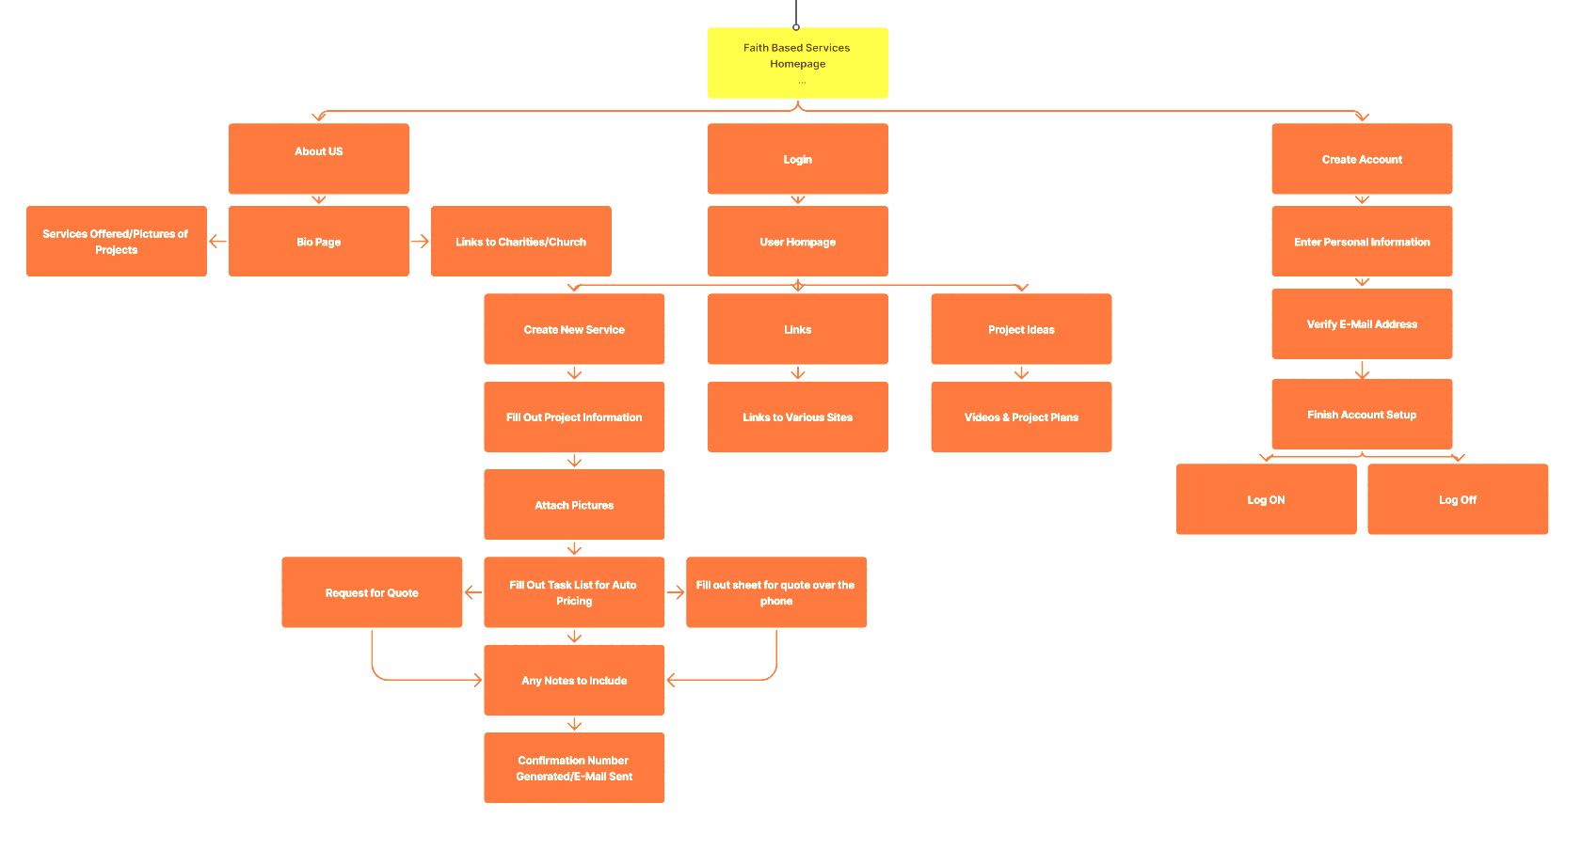
Site Structure

Slide 6
Scenario
Coweta County resident looking for handyman services.
The resident can sign up through account registration.
They can then create an appointment in real time for service.
They can request a quote for a special project or a building something.(shed, deck, patio, land/hardscaping)
The user is happy because of the easy-to-use platform and know who is coming to do the service.

Slide 7
Timeline
Week 1: Project Proposal, Design Interview Questions & Surveys, Stakeholder’s Map, Project Scope, Success Measurements
Week 2: Conduct Interviews, Develop Personas/Storyboard, Come Up With User Tasklist, Site Structure, Unique Technology Idea
Week 3: Prototype 1.0 & Testing
Week 4: Take results from observations on Prototype 1.0 Testing and work into notes for Final Prototype
Week 5: Final Prototype Development, Implementation of Unique Technology into the Prototype
Week 6: Final Prototype Testing, Develop Final Observation Report & Results
Week 7: Final Report Development, PowerPoint Presentation Development

Slide 8
Task List 1
User go to the homepage.
Click the “Create Account” icon
Go through the account creation process
Go back to the homepage and navigate to the “About Us” page
Go back to the homepage and navigate to the “Links” page
Verify the links are to the correct sources.
Navigate back to the home screen.

Slide 9
Task List 2
Go to the “Login” section on the page.
Login using the username provided.
Navigate to the “My Account” page a verify previous services.
Go Back to the “My Account” page and navigate to the New Services section
Click Custom Work and go through the process
Once finished Navigate through the Build Services process the same way
Go back to the My Account page once done.

Slide 10
Task List 3
Once into your home Page click “New Service”
Select “Handyman Service”
Once on the service selection screen select “Christmas Removal”
On the next page select 10:00a for Thursday, Jan 16.
Once on the confirmation screen select, “Pay On Service”.
Once completed please fill out the survey/questionnaire.

Slide 11
Prototype 1.0 & Testing
Was a simple sketch drawing of the website to give us an idea of what we wanted.
I’m not an artist so was very interesting.
Testing was simple interactions, that confused our user.
I did receive negative feedback on the way it was arranged.
I took the criticism and improvements with a grain of salt because this was the first time I’ve done something like this.

Slide 12
Prototype 2.0 & Testing
Was completed in Figma and interactive.
I needed to stick to basics and not go overboard as originally planned to make functional and working.
The initial date and time selector was great, I tried making some adjustments and messed it up.
I was able to make it functional and the feedback was very positive.
I know what adjustments need to be made.
Prototype Link

Slide 13
Function/Feature Design
Was an interactive clock and calendar to be able to show availability.
This took a lot of time to set-up and lost track of finishing the prototype itself.
Decided to make a stationary one at the end to be able to present what I was trying to accomplish.
I also created a simple login and account creation for the users.

Slide 14
Future Development/Impact
I would like this to be developed for the company in some way.
I would like to perfect the login and the appointment creation part, as I’ve always struggled in the programming/database realm.
I would like this to be a foundation for other companies to use as well, to be an affordable option, not breaking the bank like some services do.

Slide 15
Acknowledgements & Final Thoughts
This was a complete re-do starting week 2 as my original idea fell through because of work needing it faster.
I would like to thank Dr. Liu for being patient with me in the chaos of loosing my original idea and going through back-to-back deployments.
All those who participated.

